Slide 1
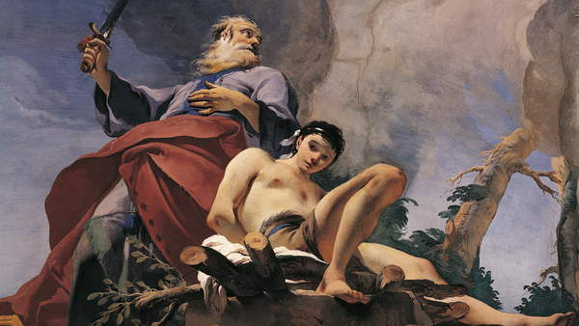
The Abraham and Isaac Motif in Modern War Poetry
Jacob Moose
Notes:
1.) INTRODUCE PAINTING
The picture selected for this slide is a segment of “The Sacrifice of Isaac” by Italian painter Giovanni Battista Tiepolo.
Created between 1726 and 1729, it is the central ceiling piece at the Archiepiscopal Palace in Udine.
I will briefly come back to this painting when discussing Anthony Hecht as this is on the cover of his final volume of poetry.

Slide 2
Genesis 22:1-19 “The Trial of Abraham” or “The Binding of Isaac” (Akedah)
² And he said, Take now thy son, thine only son Isaac, whom thou lovest, and get thee into the land of Moriah; and offer him there for a burnt offering upon one of the mountains which I will tell thee of.
(KJV)
Verses 1-2 → Command to Sacrifice Isaac
Verses 3-4 → Journey to Mount Moriah
Verses 5-10 → Preparation for Sacrifice
Verses 11-13 → Divine Intervention and arrival of Ram
Verses 14-19 → Blessing for Obedience
Notes:
1.) ABOUT THE TITLE
This story can either be referred to as “The Trial of Abraham” of “The Binding of Isaac.” Each title depends on which character is the main focus: the first looks primarily as Abraham, and the second primarily looks at Isaac.
2.) WHAT IS THE STORY ABOUT?
In this story, God commands Abraham to take his beloved son Isaac up to Mount Moriah and offer him as a burnt offering. This is generally read as God testing or “tempting” Abraham to see if he will listen. Abraham obeys God’s voice and begins his journey with Isaac.
At Moriah, Abraham builds an altar and binds Isaac to it, preparing to sacrifice him. But before he can kill his son, an Angel appears before him telling him to stop. The angel points out a ram in the thicket which Abraham can sacrifice instead.
God is pleased with Abraham’s obedience and willingness to follow through with his initial commandment. As a reward, God promises Abraham that he will give him an abundant offspring that will be uncountable.

Slide 3
The Akedah in Modern Hebrew War Poetry (David C. Jacobson, Does David Still Play Before You?: Israeli Poetry and the Bible)
Six-Day War
Lebanon War
Yom Kippur War
Rahel Negev – “The Binding”
Naomi Shemer – “The Sacrifice of Isaac”
Aliza Shenhar – “Akedah”
Yitzhak Laor – “This Idiot Isaac”
Yehuda Amichai – “The Real Hero of the Sacrifice of Isaac”
Matti Megged – poem in A Borrowed Name
Notes:
1.) HISTORY OF AKEDAH
As Professor Yeshaya made clear in his presentation, there is a long tradition of retelling Genesis 22 in Jewish, Muslim, and Christian traditions. This even dates back millennia to rabbinic texts written in 250-500 CE, as well as medieval texts from the 11th and 12th centuries.
2.) MY CONTRIBUTION
I would like to specifically look at how this story has been told in Modern War Poetry. As David C. Jacobson notes, The Akedah (or “Binding” of Isaac) plays a prominent role in post-World War II Hebrew poetry. This poetry applies the story’s narrative framework onto The Six-Day War, The First Lebanon War, The Yom Kippur War, and more. Each subverts the original story to, typically, make a political statement about war. Above are some of the most prominent examples.
SIDE NOTE: It is interesting to see how “war poetry” is seemingly expanded in the Hebrew tradition beyond the male soldier-poet (the most common voice in World War I). Women have a prominent voice, as shown above (half of the poets are women), and not all of these poets have combative war experiences. When looking at other war poetry outside of the Hebrew tradition, it is notable that many of the voices are male and have “real” war experiences. War traditions open in Western literatures during war years but tend to shift towards the masculine in postwar years (this is one feature of my thesis). One question I have is the following: how is this story retold for the Holocaust? Amir Gilboa’s “Isaac” would serve as a good example of this. I do not really think it connects well with my discussion however. I will need to think on this and do more reading.

Slide 4
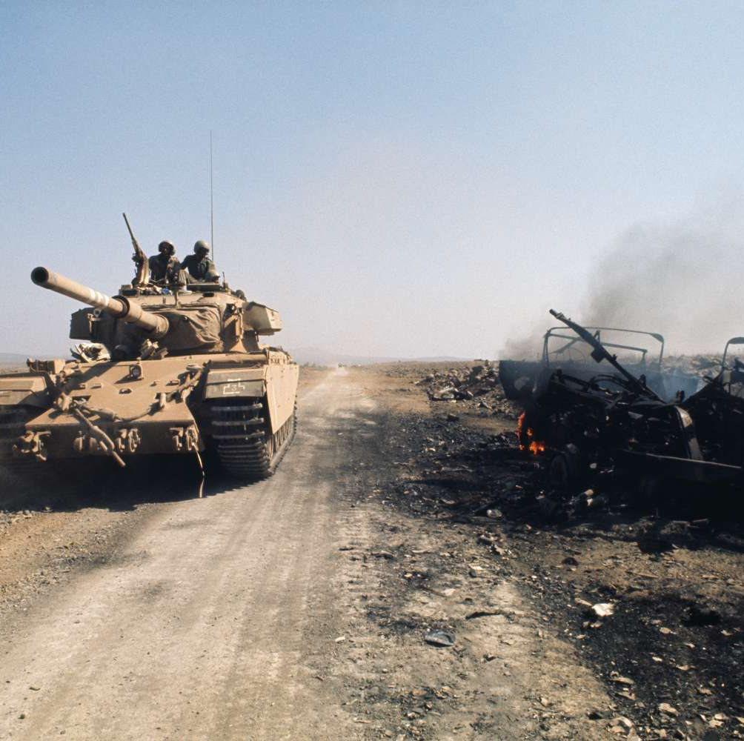
Central Theme: Youth vs. Old
“[T]he binding of Isaac story has often been used to express disillusionment with the Image of young heroic Israeli youths sacrificing themselves in war.”
(Jacobson, 24)
“Authors of Israeli biblical allusion poetry have made their contributions to the trend in Israel of comparing the older generation sending the younger to war to the binding of Isaac story.”
(Jacobson, 121)
Notes:
1.) CENTRAL THEME TO MODERN HEBREW WAR TRADITION
Young vs. Old
Youth’s being forceable sent off to fight in a war created by an older generation. This is extremely notably considering all the other possible binaries that could be created (gender, nationality, religion, etc.). It is often directly political, as well, and Amichai’ s poem will serve as an example of this (see slides 7-9).
SIDE NOTE: **Laor’s Late Version of “This Idiot Isaac” is much more empathetic towards the “Old” generation than his former poem (and the writings of the other poets). This could be interesting, but it does also seem to stick to a Youth vs. Old binary.
IMPORTANT JACOBSON QUOTES:
“Authors of Israeli biblical allusion poetry have made their contributions to the trend in Israel of comparing the older generation sending the younger to war to the binding of Isaac story (Genesis 22). This use of the binding of Isaac story can be found in biblical allusion poems responding to the last three major Arab-Israeli wars: The Six-Day Day, the Yom Kippur War, and the Lebanon War.” (121)
“The comparisons between the deaths of Israel’s youths in war and the binding of Isaac presented in the early years of the State by Moshe Shamir and Moshe Dayan suggested that such a comparison could help convey meaning to this sacrifice of life. Over time, however, the binding of Isaac story has often been used to express disillusionment with the Image of young heroic Israeli youths sacrificing themselves in war.” (94)
“The Palmach generation writer Moshe Shamir went so far as to declare that the story of the binding of Isaac was the story of his generation, reflecting their experience of the fathers sending their sons off to die in war.” (93)

Slide 5
HOW has the akedah been utilized in modern war poetry outside the Hebrew tradition?
And IS THE YOUTH VS. OLD THEME DOMINATE THERE, AS WELL?
THESIS QUESTION

Slide 6
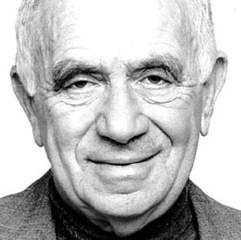
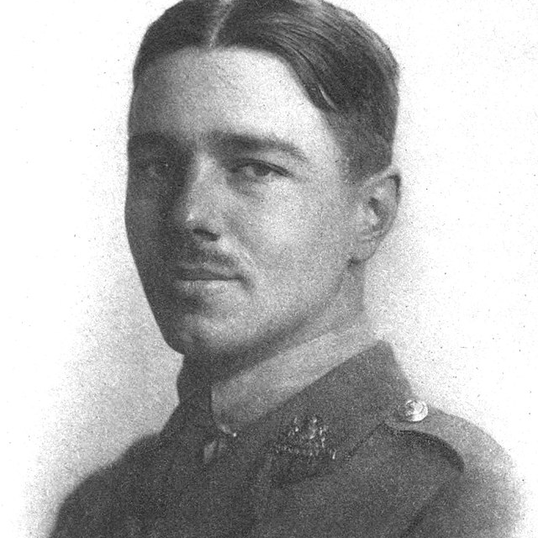
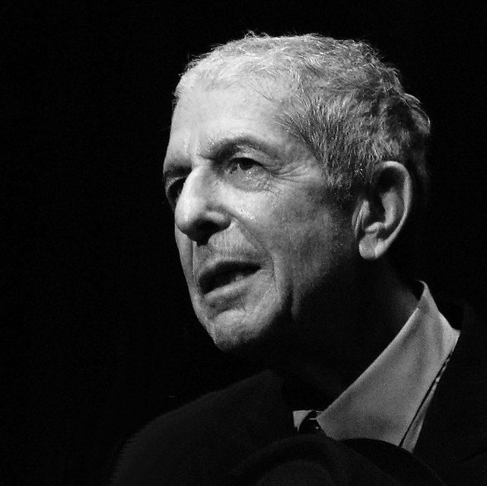
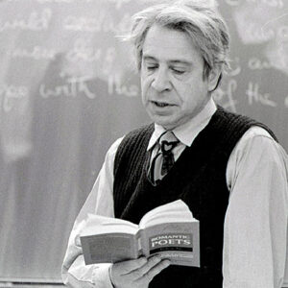
Four Poets and Four Wars
Yehuda Amichai
Wilfred Owen
Leonard Cohen
Anthony Hecht
Notes:
1.) QUCIKLY INTRODUCE POETS:
Each of these poets are associated with different wars that I will be analyzing
Yehuda Amichai – The First Lebanon War
Wilfred Owen – World War I
Leonard Cohen – Vietnam War
Anthony Hecht – World War II
2.) WHY THESE POETS?
I would like to begin by introducing one Hebrew Poet, Yehuda Amichai. I do so specifically to demonstrate how The Akedah has been used to articulate a Youth vs. Old binary dominate in Hebrew War Poetry. Though his work creates a unique image by positioning the Ram as the central character, I still think it acts as a strong representative.
Wilfred Owen shows the most similar usage of the Isaac motif. It is very clearly set up as a Youth vs. Old binary.
Leonard Cohen is also concerned with the same binary, but in different ways.
Hecht’s poem will serve as the most different – the youth vs. Old binary is not the primary concern at all.

Slide 7
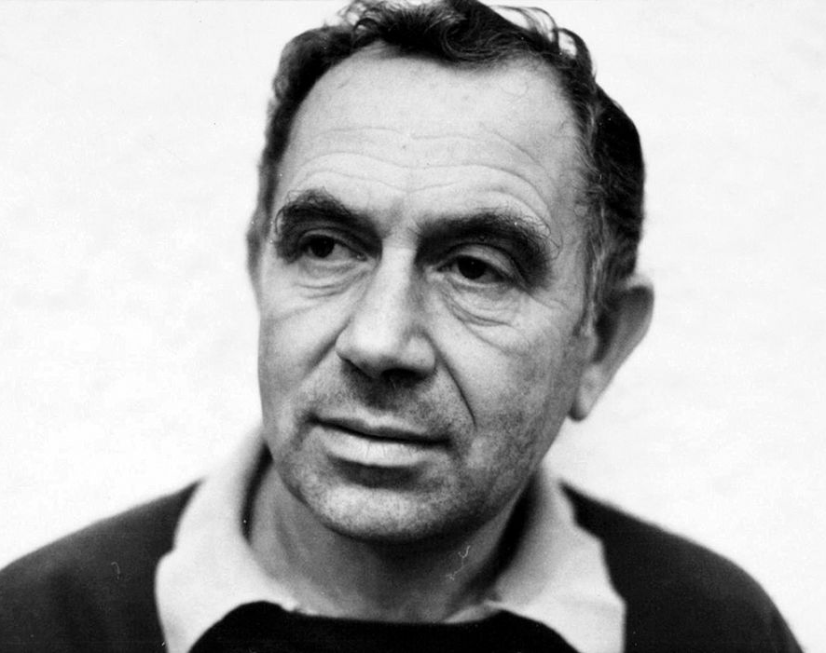
Yehuda Amichai
1924 – 2000
Born in Würzburg, Germany (fled at the age of 12 to Mandatory Palestine)
Member of the “Palmah Generation”
“I Want to Confuse The Bible”
Notes:
1.) WHO IS YEHUDA AMICHAI?
Yehuda Amichai was born in Germany to a family of “traditionally observant Jews” (Jacobson, 24).
Fighting for the British in World War II, Amichai would serve in many wars during the rest of his life, including the1948 Arab–Israeli War and Yom Kippur War. Because of his fighting for Israel’s independence in 1948 he became associated with the Palmah Generation. This generation refers to Israel’s elite military unit during its battle for independence.
2.) WHAT IS MANDATORY PALESTINE?
Leading up to World War II, his family fled to Mandatory Palestine (a British controlled area of the levant) at the age of 12 (1936).
“The word “mandatory,” in this case, refers not to necessity but to the fact that a mandate caused it to exist. That document, the British Mandate for Palestine, was drawn up in 1920 and came into effect on this day in 1923, Sept. 29. Issued by the League of Nations, the Mandate formalized British rule over parts of the Levant (the region that comprises countries to the east of the Mediterranean), as part of the League’s goal of administrating the region’s formerly Ottoman nations “until such time as they are able to stand alone.” The Mandate also gave Britain the responsibility for creating a Jewish national homeland in the region.” – Noah Rayman, “Mandatory Palestine: What It Was and Why It Matters,” Time (September 29, 2014)
3.) PALMAH GENERATION
“During World War II, he enlisted in the British army and in 1948, as a member of the elite military Palmah, he fought in Israel’s War of Independence.” (Gold,10)
“The Hagana was the largest Jewish underground defense organization, and the Palmah was its permanently mobilized strike force.” (Gold, 399)
4.) “I WANT TO CONFUSE THE BIBLE”
I’ve mentioned “I Want to Confuse the Bible” here as it demonstrates Amichai’s emphasis on reinterpreting biblical texts. The Bible has been read in such strict ways – often with politics in mind – Amichai is looking to “open it up.” The “Real Hero of The Sacrifice of Isaac” is a strong example of this.
“For some poets the need to bridge the gap between the Bible and contemporary experience is met not by merely developing new readings of the Bible but also taking the more radical step of suggesting the need to rewrite the Bible.” ( Jacobson, 69)
“Order and justice are confused: good and evil / On the table before me like salt and pepper, / The shakers are alike. I want so much / To confuse the Bible.”
“In modern society the distinctions between justice and injustice, good and evil, are no longer clear. Society is therefore incapable of constructing a clearly defined moral code.” (Jacobson, 70)

Slide 8
“The Real Hero of The Sacrifice of Isaac” (1983)
The real hero of the sacrifice was the ram Who had no idea about the conspiracy of the others. He apparently volunteered to die in place of Isaac. I want to sing a memorial song about the ram […] The angel went home Isaac went home And Abraham and God left much earlier. But the real hero of the sacrifice is the ram.
Notes:
“The Real Hero of The Sacrifice of Isaac” (1983)
The real hero of the sacrifice was the ram
Who had no idea about the conspiracy of the others.
He apparently volunteered to die in place of Isaac.
I want to sing a memorial song about the ram,
His curly wool and human eye,
The horns, so calm in his living head.
When he was slaughtered they made shofars of them,
To sound the blast of their war
Or the black of their coarse joy.
I want to remember the last picture
Like a beautiful photo in an exquisite fashion magazine:
The tanned, spoiled youngster all spiffed up,
And beside him the angel, clad in a long silk gown
For a formal reception.
Both with hollow eyes
Observe two hollow places,
And behind them, as a colored background, the ram
Grasping the thicket before the slaughter.
The angel went home
Isaac went home
And Abraham and God left much earlier.
But the real hero of the sacrifice
is the ram.
-Yehuda Amichai
Harper Collins Publishers, Inc. for the translation by Benjamin and Barbara Harshav of “The Real Hero of the Sacrifice of Isaac.” (Quoted in Jacobson, 127-128).

Slide 9
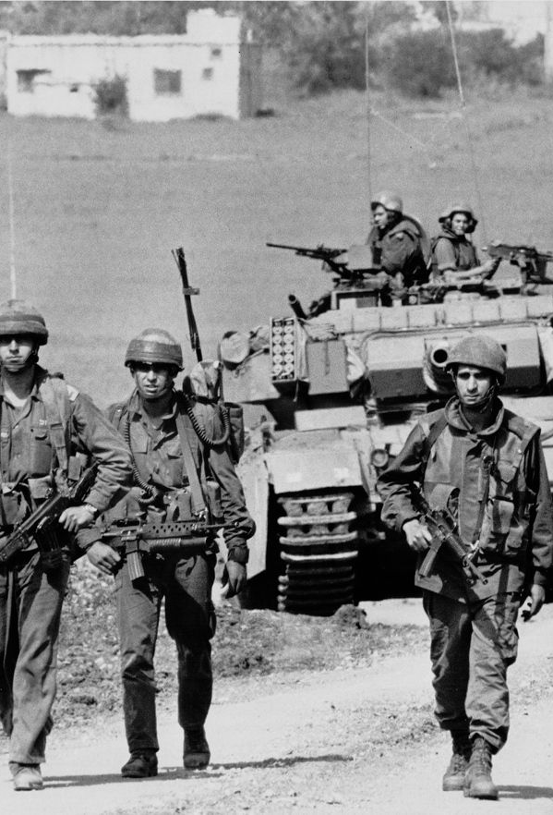
The Lebanon War (1982) “Apparent” volunteering
Unpopular war
Ram’s lack of agency = Youths sent to war
Government conspiracy?
Notes:
1.) INTRODUCTION
This poem was written during the Lebanon War of 1982. Notably, Amichai is a civilian during this time (though he has a long history of fighting in war).
The Lebanon War of 1982 was particularly unpopular.
Amichai captures the emotion of youths sent off to fight a war that wasn’t theirs through the Ram’s lack of Agency. The poem also alludes to a government conspiracy of having these youths participating in a war they don’t know much about.
Professor Yeshaya made note of this in his presentation, and I will need to do some more research. Some critics, however, have pointed beyond the Lebanon War to Amichai’s own war experiences.
After being sent to Mandatory Israel, it seems he also joined an elite military squad without fulling understanding the consequences of an Israeli war?
2.) UNPOPULAR WAR AND THE RAM
“When Yehuda Amichai seeks to capture the pain of Israelis confronting the deaths of youthful soldiers in the unpopular Lebanon War, he portrays these soldiers as victims by using the ram that is sacrificed at the end of the story of the binding of Isaac (Genesis 22) to represent them.” (Jacobson, 26)
Jacobson, 51 → General discussion on politicization of biblical images. The rise of a Israeli-right wing who used the bible to justify political decisions around war activated left-wing and humanist Israelis to read biblical stories according to different interpretations.
“Israel’s least popular war, the Lebanon War of the early 1980s, evoked much public political opposition, including the publication of many protest poems.” (Jacobson, 126)
“Yehuda Amichai puts a different twist on the comparison of Israel’s wars to the binding of Isaac by having the ram represent the contemporary victim, thereby making him the real hero of the story.” (Jacobson, 126)
“Like the ram in this version of the binding of Isaac story the deaths of the youths are not taken as seriously as they should be.” (Jacobson, 128)
“The shift of tense from the beginning to the end of the poem is significant. At the beginning of the poem, the real hero was the ram; at the end of the poem the real hero is the ram. This archetypal victimization that began in biblical times persists to this day, and it is the poet’s role to remind his society to be more sensitive to the cruelty of using youths as cannon fodder to achieve the nation’s military ends.” (Jacobson, 128)
3.) CONSPIRACY
“We can discern in this poem the sense of some Israelis at the time of the Lebanon War that there was a secret conspiracy of the government to send youths off to war without giving the nation the true story of why they were fighting. As Yair Mazor suggests, in the line stating that the ram ‘apparently […] volunteered to die in place of Isaac,’ it is clear that the ram really had no choice, and correspondingly neither did the Israeli soldiers who died in Lebanon. Thus, here Amichai is ironically undermining the Israeli army value of volunteerism in a war such as the Lebanon War, which does not seem to be justified.” (Jacobson, 128)
4.) OTHER → WAR RHETORIC // WAR AND AMICHAI’S OWN EXPERIENCES
“With the rise of Menahem Begin to political power, the Holocaust became increasingly central to political rhetoric. ‘In June, 1981,’ Segev notes, ‘Begin justified the demolition of an Iraqi nuclear facility with the words “We must protect our nation, a million and a half of whose children were murdered by the Nazis in the gas chambers.”’ In particular, Segev points out, Begin saw the violent opposition of Yasser Arafat’s Palestine Liberation Organization to Israel as historically parallel to Hitler's war against the Jews. Begin used this historical analogy to justify Israel’s invasion of Lebanon in June 1982 by declaring at the time to the Israeli government cabinet, ‘Believe me, the alternative is Treblinka, and we have decided that there will be no more Treblinkas.’” (Jacobson,144-145)
“The Land of Israel to which Amichai migrated, or rather, ‘was brought’ as a child became an arena for wars in which he was made to fight, thus being offered up as a sacrifice.”
“By the time he became a soldier, however, the scope of camouflage in his life had expanded drastically. It had become a method of social and cultural assimilation as well as a mechanism of physical self-preservation. After his migration to Palestine in his early adolescence, not sticking out became a way for Amichai to conform to the expectations placed on him. Assimilation was the rule for new immigrants, and it seemed especially desirable to a twelve-year-old boy who just wanted to fit in. As a result of this social pressure, Amichai did no identify himself as an immigrant or a refugee, but instead as a member of the elite generation that struggled for Israel’s independence. Thus, Amichai’s poetic theme of a façade that conceals the truth applies to how he formed his Israeli identity as well.”

Slide 10
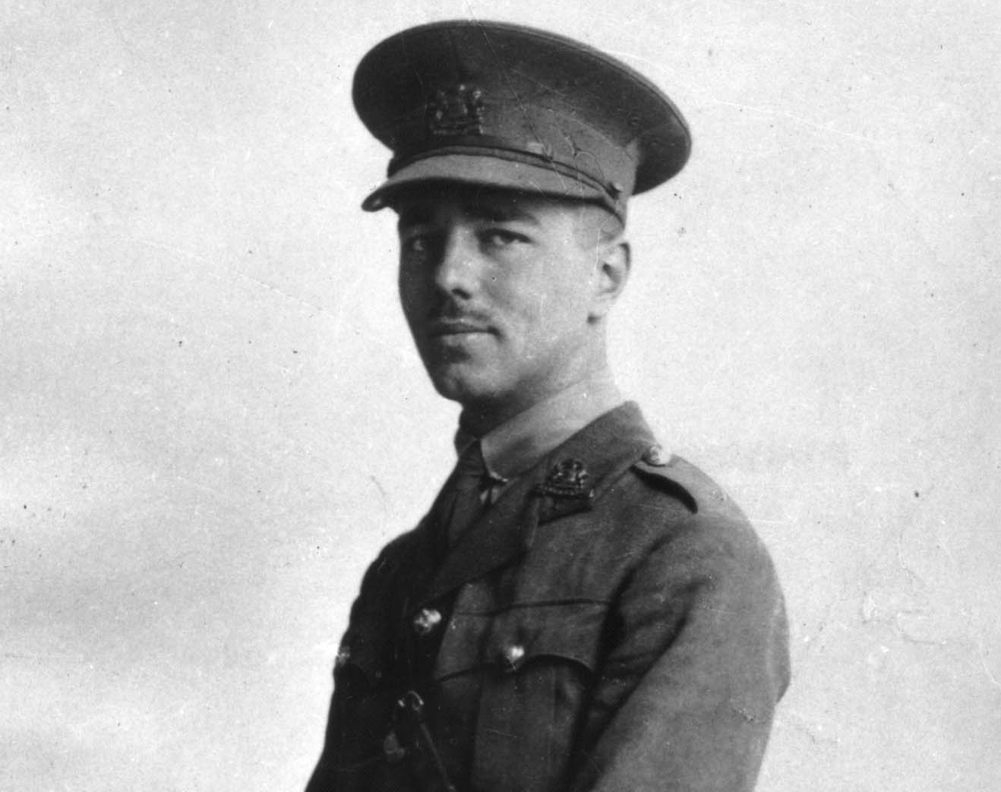
Wilfred Owen
1893 – 1918
Born in England
Prominent “trench poet” of World War I
Killed in Action (age 25)
Notes:
1.) INTRODUCTION
Wilfred Owen is one of Britain's most famous trench poets. A Language instructor for Berlitz (In Bordeaux) before the war (Wohl, 101), he was drafted in 1914 for World War I.
Died at the age of 25 only one week before the armistice was declared (Death date: November 4th … Armistice: November 11th)

Slide 11
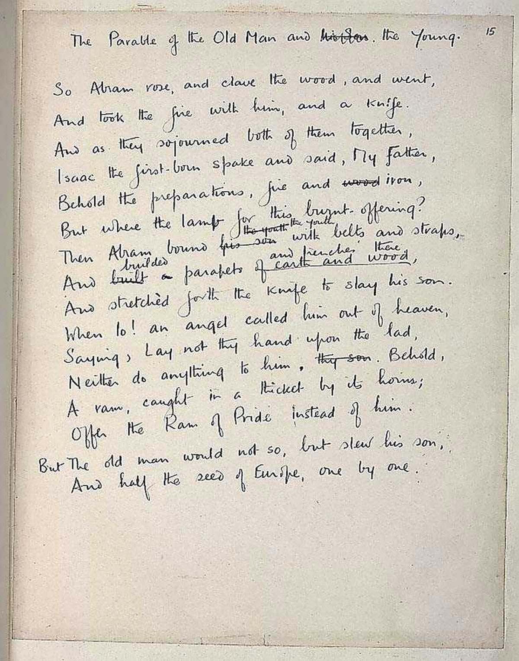
“The Parable of the Old Man and the Young” (1920)
[…]
Then Abram bound the youth with belts and straps, and builded parapets and trenches there, And stretchèd forth the knife to slay his son. When lo! an angel called him out of heaven, Saying, Lay not thy hand upon the lad,
[…] Offer the Ram of Pride instead of him. But the old man would not so, but slew his son, And half the seed of Europe, one by one.
Notes:
“The Parable of the Old Man and the Young” (1920)
So Abram rose, and clave the wood, and went,
And took the fire with him, and a knife.
And as they sojourned both of them together,
Isaac the first-born spake and said, My Father,
Behold the preparations, fire and iron,
But where the lamb for this burnt-offering?
Then Abram bound the youth with belts and straps,
and builded parapets and trenches there,
And stretchèd forth the knife to slay his son.
When lo! an angel called him out of heaven,
Saying, Lay not thy hand upon the lad,
Neither do anything to him. Behold,
A ram, caught in a thicket by its horns;
Offer the Ram of Pride instead of him.
But the old man would not so, but slew his son,
And half the seed of Europe, one by one.
- Wilfred Owen
First published in 1920 by Siegfried Sassoon

Slide 12
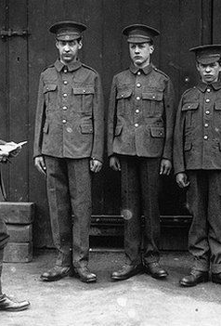
World War I: “doomed youth led blindly to the slaughter by cruel age” (WOHL, 106)
Emphasis on title: “Old Man” vs. “The Young”
“Belt,” “Straps,” “Trenches,” and World War I
Slaying of Isaac and “seed of Europe”
Notes:
1.) LINK TO WORLD WAR I
Owen’s poem follows similar to the themes in Modern Hebrew war poetry. There is a strong emphasis on age differences and the young suffering at the hands of the old. This can be seen in the title itself.
The altar is directly connected to the “trenches”
Interesting is Owen’s use of “Seed.” One of the rewards God promised Abraham was an uncountable offspring. In this poem, the offspring as been given but Abraham chooses to kill them all one by one.

Slide 13
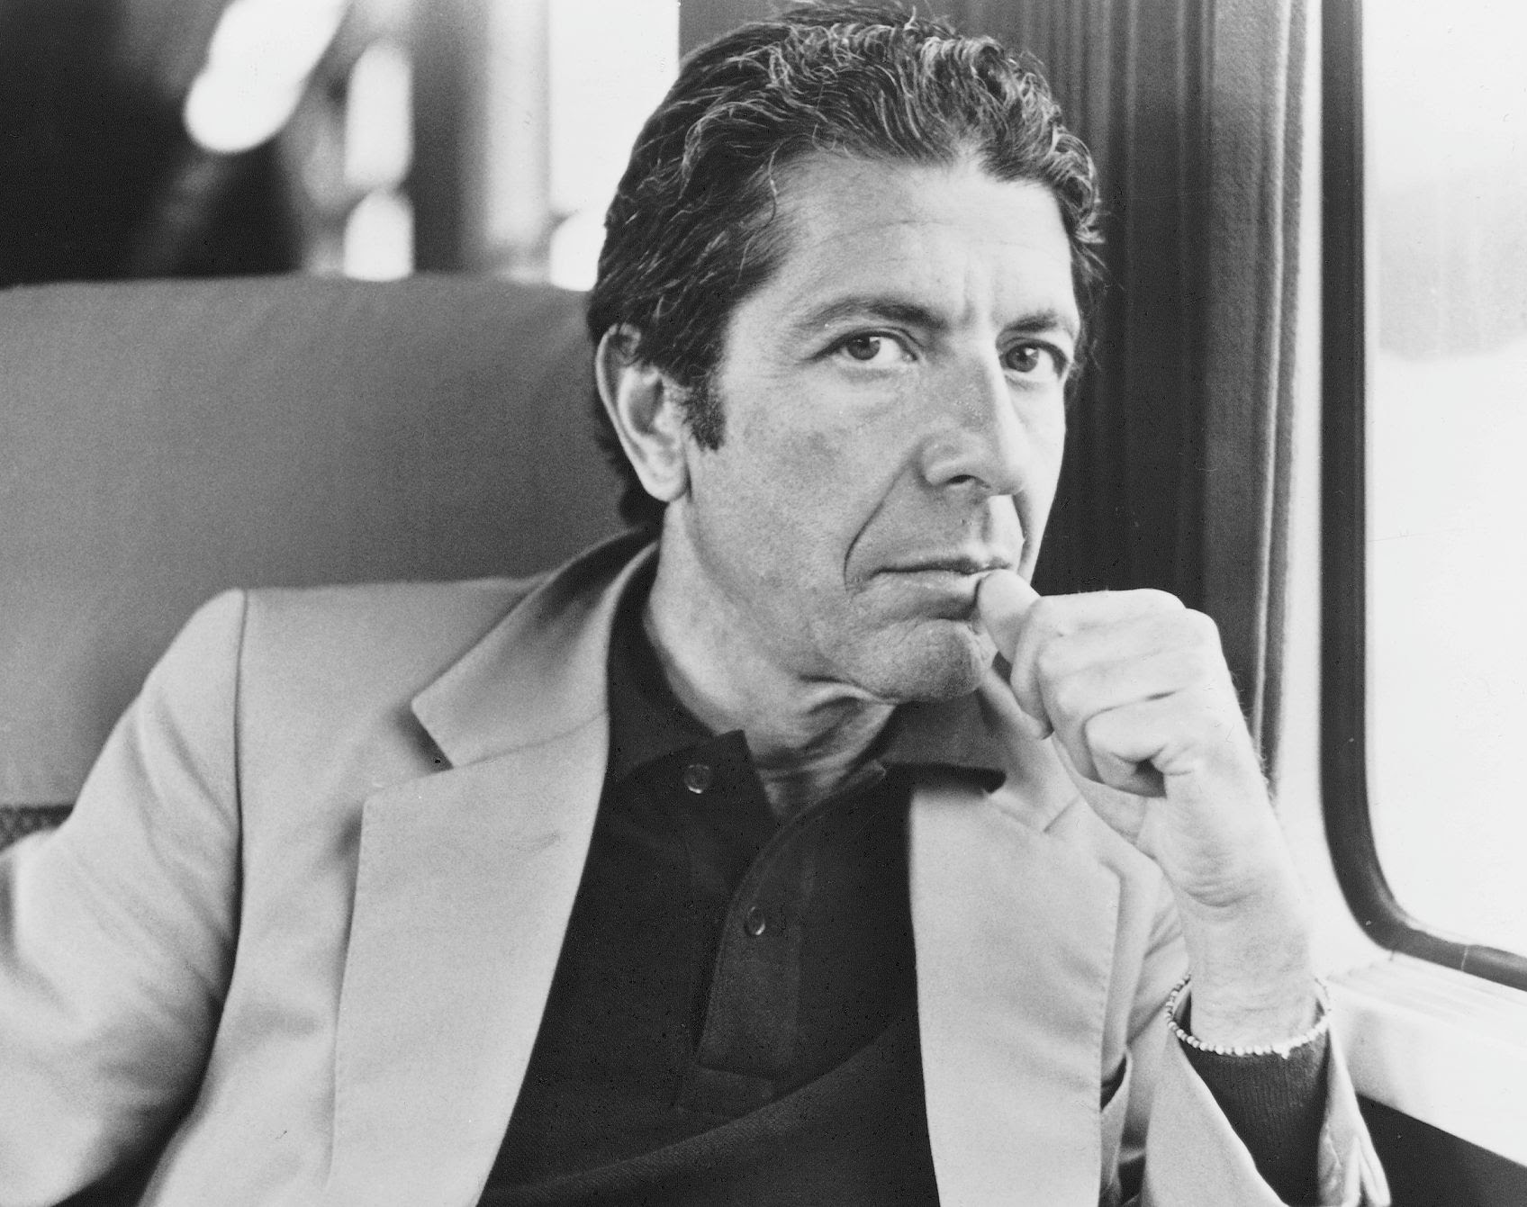
Leonard Cohen
1934 – 2016
Born in Montreal, Canada
1960s, Protest, and Vietnam
Yom Kippur Protest 1973
Notes:
1.) ABOUT LEONARD COHEN
Of all the poet’s I have looked at, Cohen is the one who did not serve in combative military positions at all. His music career notably off in the 1960s, and he was situated with certain Anti-Vietnam scenes while living in American (Judy Collins concert).
Later in his life, he would also be remembered for doing a frontline performance for Israeli troops in the 1973 Yom Kippur War.

Slide 14
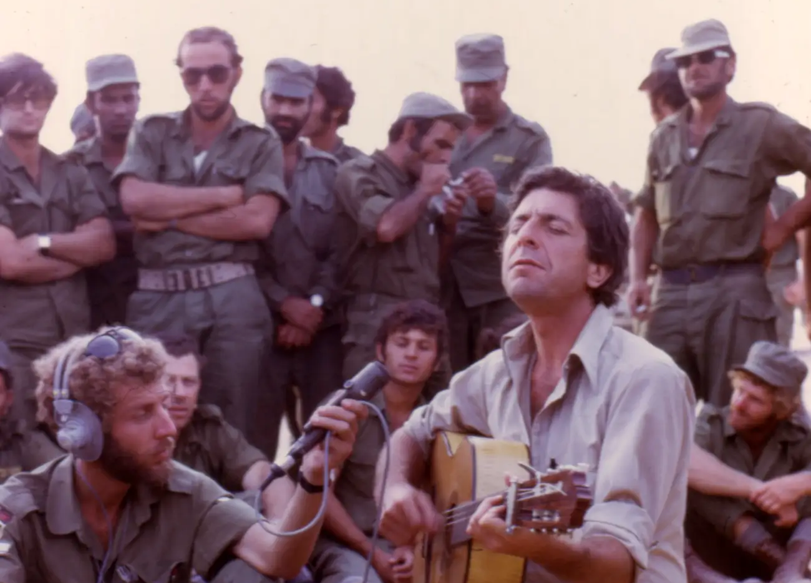
Notes:
Picture of Leonard Cohen Singing with Troops

Slide 15
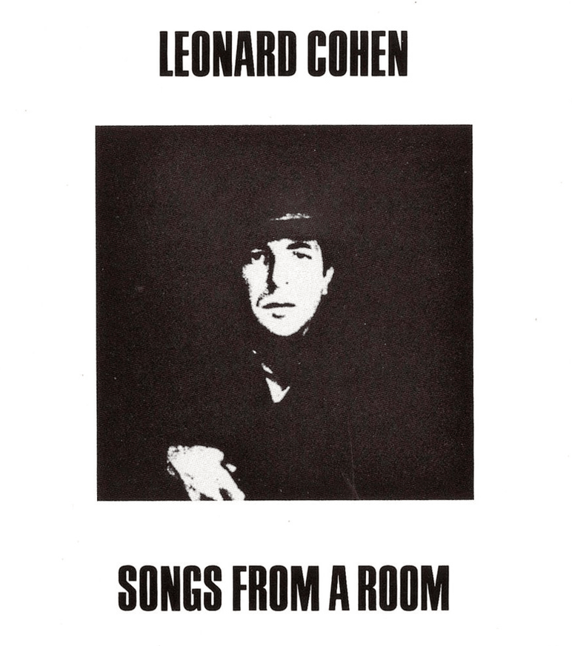
“Story of Isaac” (1969)
[…]
You who build the altars now To sacrifice these children You must not do it anymore A scheme is not a vision You never have been tempted By a demon or a god You who stand above them now Your hatchets blunt and bloody You were not there before When I lay upon a mountain And my father's hand was trembling With the beauty of the word
[…]
Notes:
“The Story of Isaac” (1973)
The door it opened slowly My father he came in I was nine years old And he stood so tall above me Blue eyes they were shining And his voice was very cold
Said I've had a vision And you know I'm strong and holy I must do what I've been told So we started up the mountain I was running he was walking And his axe was made of gold
Well the trees they got much smaller The lake a lady's mirror We stopped to drink some wine Then he threw the bottle over Broke a minute later And he put his hand on mine
Thought I saw an eagle But it might have been a vulture I never could decide Then my father built an altar He looked once behind his shoulder He knew I would not hide
You who build the altars now To sacrifice these children You must not do it anymore A scheme is not a vision You never have been tempted By a demon or a god
You who stand above them now Your hatchets blunt and bloody You were not there before When I lay upon a mountain And my father's hand was trembling With the beauty of the word
And if you call me brother now Forgive me if I inquire Just according to whose plan When it all comes down to dust I will kill you if I must I will help you if I can
When it all comes down to dust I will help you if I must I will kill you if I can Have mercy on our uniform Man of peace or man of war The peacock spreads his fan
- Leonard Cohen

Slide 16
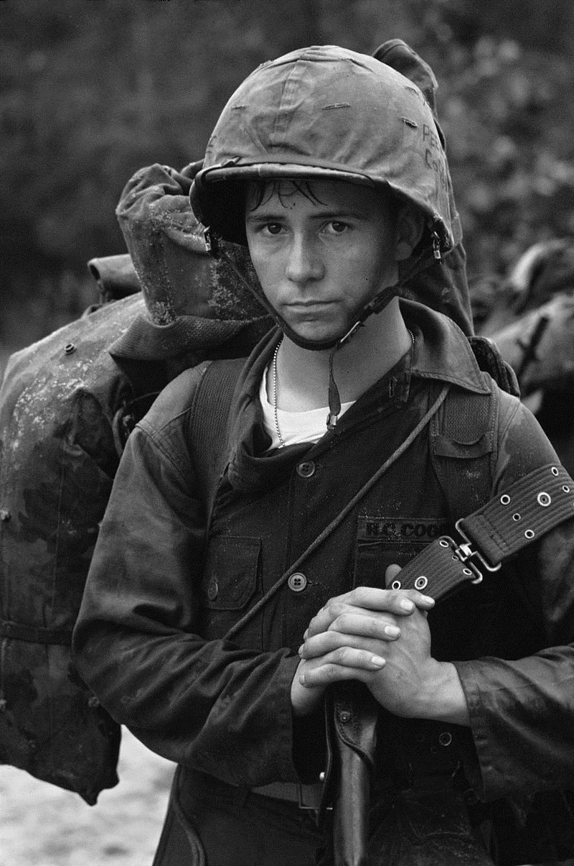
Beyond Vietnam? Sacrifice and Corrupt Human Nature
“I was careful in that song to try and put it beyond the pure, beyond the simple, anti-war protest, that it also is. Because […] it isn't necessarily for war that we're willing to sacrifice each other. We'll get some idea - some magnificent idea - that we're willing to sacrifice each other for; it doesn't necessarily have to involve an opponent or an ideology, but human beings being what they are we're always going to set up people to die for some absurd situation that we define as important.” (Interview with John Mackenna)
Notes:
1.) INTERVIEW WITH JOHN MACKENNA
Cohen’s direct relationship to Vietnam protest speaks in this story. But, in an interview with John Mackenna, Cohen poems his retelling will include and expand beyond the war. Cohen’s particular concern is with the ideologies or the parts of “human nature” that make war’s happenings occur in the first place. I choice this poem specifically because out of all the poets, Cohen is the only civilian (excluding Amichai, though Amichai also has lots of war experience) writing on war and sees beyond the literal. The same was true for some other noncombatants in World War II, like Marianne Moore. Her poem “In Distrust of Merits” is my thesis (also why Cohen’s civilian status is on my mind).
QUOTATION
“I was careful in that song to try and put it beyond the pure, beyond the simple, anti-war protest, that it also is. Because it says at the end there the man of war the man of peace, the peacock spreads his deadly fan. In other words it isn't necessarily for war that we're willing to sacrifice each other. We'll get some idea - some magnificent idea - that we're willing to sacrifice each other for; it doesn't necessarily have to involve an opponent or an ideology, but human beings being what they are we're always going to set up people to die for some absurd situation that we define as important.” (How The Heart Approaches What It Yearns (leonardcohenfiles.com))

Slide 17
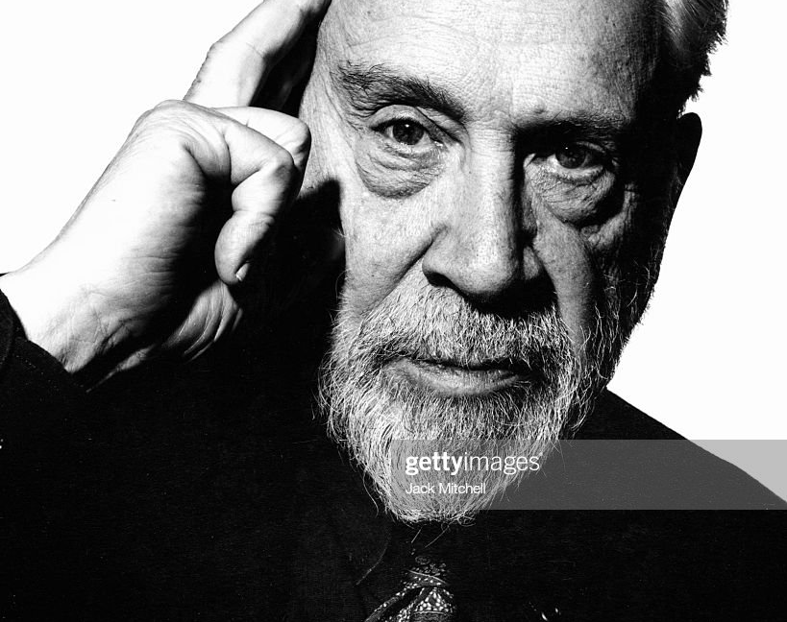
Anthony Hecht
1923 – 2004
Born in New York City
World War II
Joins Army Reserves 1943
Combat at European Front (February – June 1945)
Liberation of Flossenbürg
Notes:
1.) SHORT WAR BIOGRAPHY
Between 1943 and February of 1945, Hecht was stationed at a number of different forts across the country while preparing for deployment to Europe. Letters sent home in these years reflect an overwhelming spirit of boredom and depression caused by the army. At Fort Leonard Wood in 1944 he wrote his parents, “I fear that I shall once again fall into that mental slump which is so necessary to being a good soldier. After one week here, my thoughts have already become less coherent. This is liable to be the most depressing feature of army life again for me.” This sentiment was not uncommon during the war, and poets such as Randall Jarrell explicitly addressed it in the postwar years. But in February of 1945, Hecht was finally deployed to the European Front and spent four dreadful months fighting across France, Czechoslovakia, and Germany. Though this experience was relatively short, it was marked by an intense violence that he would carry with him in the years to come.”
- quote from Hecht, The Letters of Anthony Hecht, edited by Jonathan Post [late March / early April 1944] Fort Leonard Wood, Missouri.
2.) FLOSSENBURG
Flossenbürg was an annex of Buchenwald,” Hecht told Philip Hoy in 2004, that was “both an extermination camp and a slave-labour camp, where prisoners were made to manufacture Messerschmitts at a factory right within the perimeter of the camp. […] Prisoners were dying at the rate of 500 a day from typhus […] [and] [their] accounts were beyond comprehension.” According to Hecht, this was “the greatest trauma of the war” for him and one that left him “shrieking” in the night for years. Later, Hecht read extensively on the experiences of Jewish prisoners at camps like Flossenbürg and implemented many of them into his poetry. This can be seen most clearly in poems such as “More Light! More Light!” and “The Book of Yolek.” - Quote from Philip Hoy and Anthony Hecht, In Conversation, 26-27.
The famous Christian theologian Dietrich Bonhoeffer was murdered at this camp shortly before its liberation

Slide 18
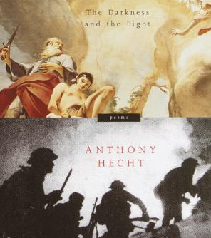
“Sacrifice” (2001)
ABRAHAM
ISAAC
1945
Notes:
1.) BOOK COVER
Please note the cover of the work on the right of this slide. This is Anthony Hecht’s final volume of poetry The Darkness and The Light (2001). I mentioned on the first slide that I would be coming back to Tiepolo’s painting. Here you see it’s direct association with war and violence on the cover art.
2.) ABOUT SACRIFICE
“Sacrifice” is split up into three separate sections. The first is voiced by Abraham, the second by Isaac, and the third by an external narrator focalizing an interaction between a Nazi soldier and a French family. Though all three parts are particularly pertinent to my paper, I would like to focus on the third section in this PowerPoint.
Interesting fact: some 2 million bicycles were taken from the Netherlands by Nazi soldiers during World War II. Roughly half of the countries 4 million.

Slide 19
“Sacrifice” (2001)
[…]
It wasn’t charity. Perhaps mere prudence, Saving a valuable round of ammunition For some more urgent crisis. Whatever it was, The soldier reslung his rifle on his shoulder, Turned wordlessly and walked on down the road The departed German vehicles had taken. There followed a long silence, a long silence. For years they lived together in that house, Through daily tasks, through all the family meals, In agonized, unviolated silence.”
Notes:
I Abraham
Long years, and I found favor In the sight of the Lord, who brought me out of Ur To where his promise lay, There with him to confer On Justice and Mercy and the appointed day Of Sodom’s ashen fate; For me he closeted sweetness in the date, And gave to salt its savor.
Three promises he gave, Came like three kings or angels to my door: His purposes concealed In coiled and kerneled store He planted as a seedling that would yield In my enfeebled years A miracle that would command my tears With piercings of the grave.
“Old man, behold Creation,” Said the Lord, “the leaping hills, the thousand-starred Heavens and watery floor. Is anything too hard For the Lord, who shut all seas within their doors?” And then, for his name’s sake He led me, knowing where my heart would break, Into temptation.
The whole of my long life Pivoted on one terrible day at dawn. Isaac, my son, and I Were to Moriah gone. There followed an hour in which I wished to die, Being visited by these things: My name called out, the beat of gigantic wings, Faggots, and flame, and knife.
II Isaac
Youthful I was and trusting and strong of limb, The fresh-split firewood roped tight to my back, And I bore unknowing that morning my funeral pyre. My father, face averted, carried the flame, And, in its scabbard, the ritual blade he bore. It seemed to me at the time a wearisome trek.
I thought of my mother, how, in her age, the Lord Had blessed her among women, giving her me As joke and token both, unlikelihood Being his way. But where, where from our herd Was the sacrifice, I asked my father. He, In a spasm of agony, bound me hand and foot.
I thought, I am poured out like water, like wax My heart is melted in the midst of my bowels. Both were tear-blinded. Hate and love and fear Wrestled to ruin us, savage us beyond cure. And the fine blade gleamed with the fury of live coals Where we had reared an altar among the rocks.
Peace be to us both, to father Abraham, To me, elected the shorn stunned lamb of God— We were sentenced, and reprieved by the same Voice— And to all our seed, by this terror sanctified, To be numbered even as the stars at the small price Of an old scapegoated and thicket-baffled ram.
III 1945
It was widely known that the army of occupation Was in full retreat. The small provincial roads Rumbled now every night with tanks and trucks, Echoed with cries in German, much Mach schnell, Zurück, ganz richtig, augenblicklich, jawolh, Audible in the Normandy countryside. So it had been for days, or, rather, nights, The troops at first making their moves in darkness, But pressures of haste toward the end of March Left stragglers to make their single way alone, At their own risk, and even in daylight hours.
Since the soldiers were commandeering anything They needed—food, drink, vehicles of all sorts— One rural family dismantled their bicycle, Daubed the chrome parts—rims, sprocket, spokes—
with mud, And wired them carefully to the upper boughs Of the orchard. And the inevitable came In the shape of a young soldier, weighted down With pack and bedroll, rifle, entrenching tools, Steel helmet and heavy boots just after dawn. The family was at breakfast. He ordered them out In front of the house with abusive German words They couldn’t understand, but gesture and rifle Made his imperious wishes perfectly clear. They stood in a huddled group, all nine of them. And then he barked his furious command: Fahrrad! They all looked blank. He shouted again: FAHRRAD! FAHRRAD! FAHRRAD!, as though sheer
volume Joined with his anger would make his meaning plain. The father of the family experimentally Inquired, Manger? The soldier, furious, At last dredged up an explosive Bicyclette, Proud of himself, contemptuous of them. To this the father in a small pantomime— Shrugged shoulders, palms turned out, a helpless, long, Slow shaking of the head, then the wide gesture Of an arm, taking in all his property— Conveyed Nous n’avons pas de bicyclettes More clearly than his words. To the young soldier This seemed unlikely. No one could live this far From neighbors, on a poor untraveled road That lacked phone lines, without the usual means Of transport. There was no time to search The house, the barn, cowsheds, coops, pens and grounds. He looked at the frightened family huddled together, And with the blunt nose of his rifle barrel Judiciously singled out the eldest son, A boy perhaps fourteen, but big for his years, Obliging him to place himself alone Against the whitewashed front wall of the house. Then, at the infallible distance of ten feet, With rifle pointed right at the boy’s chest, The soldier shouted what was certainly meant To be his terminal order: BICYCLETTE!
It was still early on a chilly morning. The water in the tire-treads of the road Lay clouded, polished pale and chalked with frost, Like the paraffin-sealed coverings of preserves. The very grass was a stiff lead-crystal gray, Though splendidly prismatic where the sun Made its slow way between the lingering shadows Of nearby fence posts and more distant trees. There was leisure enough to take full note of this In the most minute detail as the soldier held Steady his index finger on the trigger.
It wasn’t charity. Perhaps mere prudence, Saving a valuable round of ammunition For some more urgent crisis. Whatever it was, The soldier reslung his rifle on his shoulder, Turned wordlessly and walked on down the road The departed German vehicles had taken.
There followed a long silence, a long silence. For years they lived together in that house, Through daily tasks, through all the family meals, In agonized, unviolated silence.
- Anthony Hecht

Slide 20

World War II God on Trial?
Abraham in impossible position
Post-“ritual” consequences
No blessing – Silence, including from God
Notes:
1.) GOD ON TRIAL?
Rather than focusing specifically on a youth vs. old binary, “Sacrifice” emphasizes the cruelty behind God’s test.
2.) ABRHAM IN IMPOSSIBLE POSITION
The Father in the third section who represents Abraham is particularly put in a difficult position – without the bicycle, he knows his family will suffer and possibly die without it.
3.) POST-”RITUAL” CONSEQUENCES
But the consequence is, what, his son? It’s completely unfair and there is no divine intervention. The soldier thinks more utilitarian and leaves. Of course, being put in such as situation has dreadful consequences in the family.

Slide 21

Question: Religion? Nationality?
Wilfred Owen
Christian Influences
British
Anthony Hecht
(Secular) Jewish
American
Leonard Cohen
Jewish
Canadian
Yehuda Amichai
(Secular) Jewish
German/Israeli

Slide 22
Question: Diversifying Authors?
Emily Dickinson
“Abraham to kill him”
The Civil War(?)
Rahel Negev
“The Binding”
Naomi Shemer
“The Sacrifice of Isaac”
Aliza Shenhar
“Akedah”

